Slide 1
Exploratory Data Analysis
Analyzing dataset for Brainer
July 24, 2018

Slide 2
Agenda
Descriptive analysis
Univariate analysis of different drugs and promotions
Correlation among different drugs
Time series analysis on drugs and promotion
Analysis of promotion and its influence
References

Slide 3
Adapazide is the leader in terms of sales
Background and Objectives
Top 3 Drugs and their sales (7 years)
More findings from the dataset
Adapazide - US $173 million
Trantalol - US $103 million
Lansoprofen - US $96 million
Adapazide contributes the most to the overall revenue with the highest median (monthly) of US $1,911,382
Oxozone is the poorest performer with just US $98,889 as median
Adapazide’s sales skyrockets the most with a record sale of US $4,124,399 which is also reflected on its standard deviation (US $ 596,939) and skewness of 1.64
Average skewness of all the drugs is 1.21 (Positively skewed)
Drugs with the least sales (7 years)
Tetrapil - US $8.9 million
Oxozone – US $9.1 million
Afirudin - US $10.8 million
Note:
No missing values found
No duplicate rows found

Slide 4
Agenda
Descriptive analysis
Univariate Outlier analysis of different drugs
Correlation among different drugs
Time series analysis on drugs
Analysis of promotion and its influence
References

Slide 5
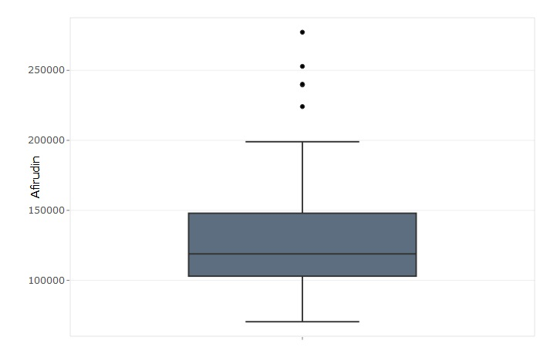
Univariate Outlier analysis

Slide 6
Inference from univariate outlier analysis
The boxplot helps us in detecting the outliers for a particular drug. The boundary or the extreme lines are at +1.5IQR and -1.5IQR. Any value outside of this range is treated as an outlier.
From the boxplot, the total outliers (67) have been identified.
After analyzing the outliers, it has been identified that there is no outlier for a month where there is no promotion.
The effect of promotion on the outliers are identified and plotted into the bar graph in previous slide.
Promotion 4 has caused the maximum outliers (27) and promotion 3 has caused the minimum outliers (5).

Slide 7
Agenda
Descriptive analysis
Univariate analysis of different drugs and promotions
Correlation among different drugs and promotions
Time series analysis on drugs
Analysis of promotion and its influence
References

Slide 8
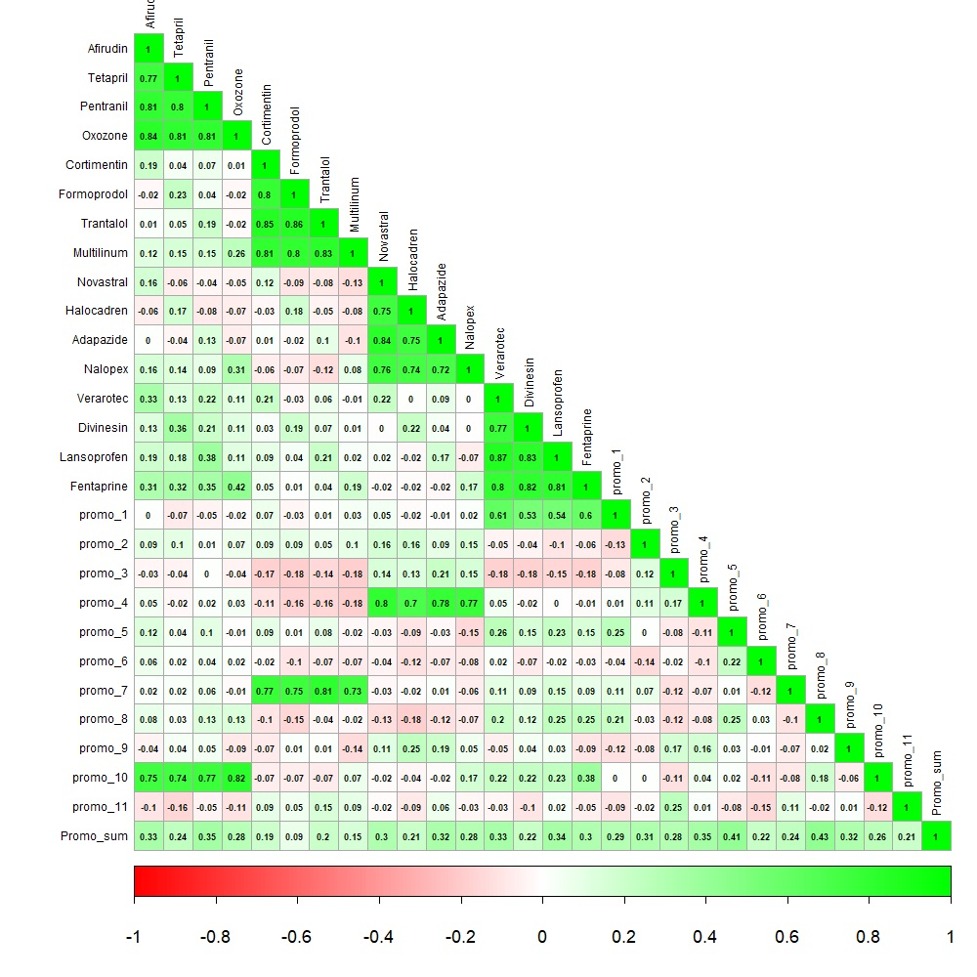
Correlation among different drugs and promotions

Slide 9
Inference from Correlation matrix
Relationship between individual drugs in the set have high positive correlation among them.
Drug set 1 is highly correlated with promotion type 10.
Drug set 2 is highly correlated with promotion type 7.
Drug set 3 is highly correlated with promotion type 4.
Drug set 4 is highly correlated with promotion type 1.

Slide 10
Agenda
Descriptive analysis
Univariate analysis of different drugs and promotions
Correlation among different drugs
Time series analysis on drugs
Analysis of promotion and its influence
References

Slide 11
Time series analysis on drugs

Slide 12
Time series analysis on drugs
Pentranil, Trantalol, Adapazide and Lansoprofen are the best performing drug in respective groups
Overall Adapazide has the highest sales over the years
Overall Tetapril has the least sales over the years
Trantalol has a declining trend and Lansoprofen has a growing trend

Slide 13
Agenda
Descriptive analysis
Univariate analysis of different drugs and promotions
Correlation among different drugs
Time series analysis on drugs
Analysis of promotion and its influence
References

Slide 14
Analysis on promotion and its influence
Irrespective of the type of promotion over the months, the total promotion count remains the same (12) for every year
The most targeted months for promotion over 7 years are Jan, May, June and Dec
The trend line helps us to predict the number of promotion that might happen next year
Most used promotion type – Promo 6 and Least used promotion type – 1 & 5

Slide 15
Agenda
Descriptive analysis
Univariate analysis of different drugs and promotions
Correlation among different drugs
Time series analysis on drugs
Analysis of promotion and its influence
References

Slide 16
References
https://eoc.mu-sigma.com/search/app/info/Room/3fac1765-0af4-4cc2-83d6-9aa7f6328b6d
https://eoc.mu-sigma.com/search/app/info/Brick/2caeb5f2-8af2-4402-bc6f-e221645be7cf
https://eoc.mu-sigma.com/search/app/info/Brick/57023de1-2cd8-46b9-a8a5-150529808a44
https://whatis.techtarget.com/definition/statistical-analysis
https://www.sas.com/en_us/insights/analytics/statistical-analysis.html

